Slide 1
Where to work in finance?

Slide 2

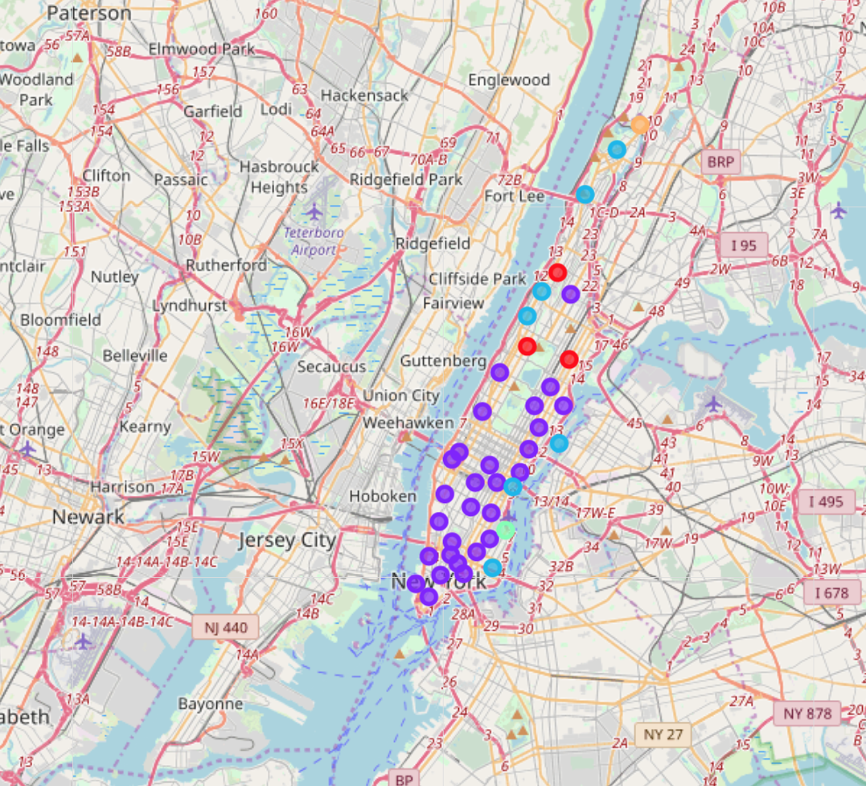
Manhattan
Many unique neighborhoods

Slide 3
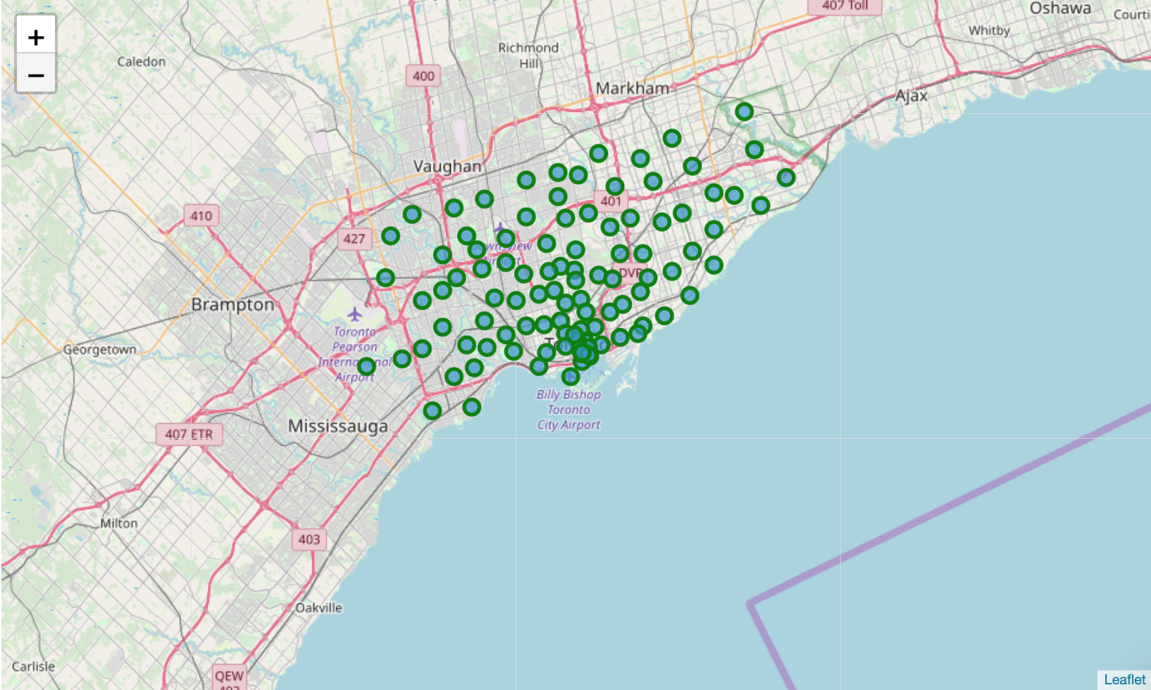
Toronto
Less unique neighborhoods

